Slide 1
REALISTIC FACE IMAGE GENERATOR BASED ON GENERATIVE ADVERSARIAL NETWORK
By
P.Sai Venunath
1602-16-737-038
N.Sri surya
1602-17-737-049
A18 Team

Slide 2
Contents
-->Introduction
-->Literature
-->Method Description
-->Implementation
-->Technology Stack
-->Results

Slide 3
Introduction
Generative adversarial networks (GANs) are algorithmic architectures that use two neural networks, pitting one against the other (thus the “adversarial”) in order to generate new, synthetic instances of data that can match for real data. They are used widely in image generation, video generation and voice generation

Slide 4
--->In the current research on the automatic generation of images, the idea of using GAN is widely adopted.
--->We create an image generation model based on GAN, tests it on the CelebA dataset, and compares the model with the results of Deep Convolution Generative Adversarial Networks (DCGAN) and Wasserstein Generative Adversarial Networks (WGAN). The experimental results show that our model has better performance on image generation.

Slide 5
Literature
As a new generation model framework, the Generative Adversarial Network proposed can generate a composite image that is better than the previous generation model, and has since become one of the most popular research fields. The Generative Adversarial Network includes two neural networks, a generator and a discriminator, wherein the generator attempts to generate a real sample discriminator attempts to distinguish between the real sample and the generated sample from the generator

Slide 6
Method
GAN inspires from the two-player game in game theory.
The two players in the GAN model are respectively
composed of a generative model and a discriminative model.

Slide 7
Implementation
We create
1) Model
2) Discriminator Network
3) Generator network

Slide 8
The Generator’s job is to create realistic-looking fake images, while the Discriminator’s job is to distinguish between real images and fake images. If both are functioning at high levels, the result is images that are seemingly identical real-life photos
For measuring the quality of the generated image we use hyper- parameter

Slide 9
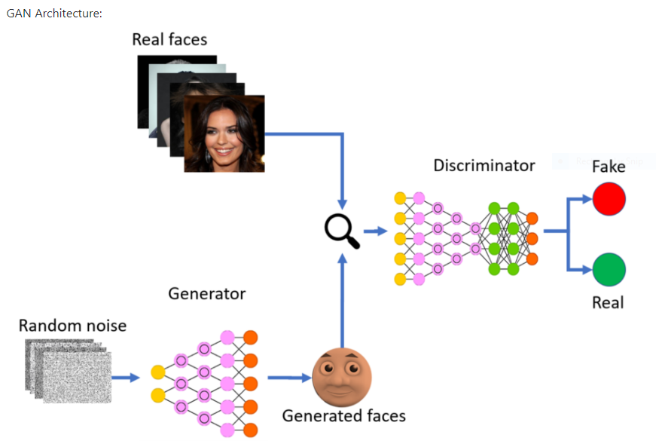

Slide 10
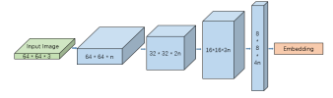
Discriminator Network

Slide 11

Generator Network

Slide 12
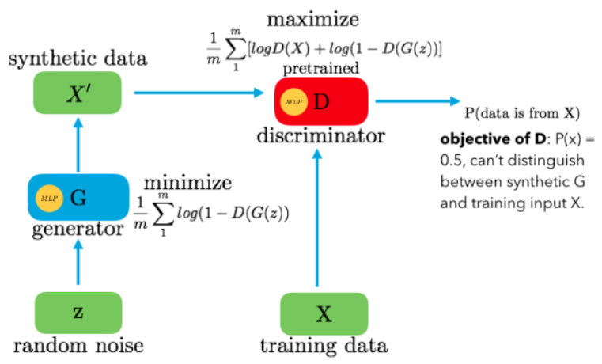
Math Behind GANs

Slide 13
Parameters
X= Actual Data
Z=Random Noise
D=Discriminator
G=Generator
X’=Synthetic Data

Slide 14
Hyper parameter
For measuring the quality of the generated image we use hyper-parameter
However, there is a problem at this time: if the discriminator cannot discriminate between the generated sample and the real sample, then their error distribution and their expected errors will be the same.

Slide 15
To solve this problem, we introduce a hyper-parameter γ that can help the generator and the discriminator balance the assignment tasks so that the two sides are balanced and the above problem does not occur.
The low γ value will result in poor image diversity, because the discriminator is too concerned about self-encoding the real image, so the best value of γ is between [0, 1].

Slide 16
Dataset-CelebA
This paper conducted training and testing of the model on the CelebA dataset. The CelebA Face Dataset [2] is the open data of The Chinese University of Hong Kong, which contains 202,599 face images of 10,177 celebrity identities, all of which have been feature-marked, which is a very useful dataset for face-related experiments.

Slide 17
Experiment
In this section, we will introduce the train and test results of our two models (64×64 and 128×128) on the celebA dataset, and we will compare the results with the classic DCGAN and WGAN architecture. The specific experimental procedures and results are as follows

Slide 18
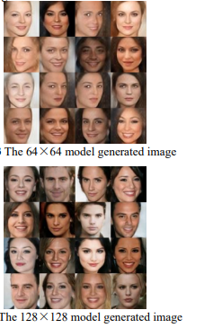

Slide 19
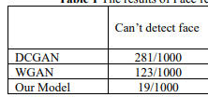
Test/Verify

Slide 20
Technology Stack
Software Requirements
Labelled Faces in the Wild (original dataset without funnelling)
Python Notebook
Python 2.7 (only tested with that version)
Scipy
Numpy
scikit-image

Slide 21
System Requirements
Tensor flow framework 1.10.0
11 Gb DRAM
Anaconda3
64-bit Python 3.6

Slide 22
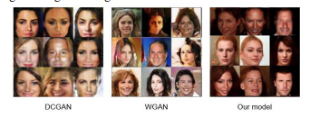
Results

Slide 23
Conclusion
This paper proposes a new network architecture based on the Generative Adversarial Network, and designs the image generation model based on the TensorFlow deep learning framework. In the experiment, we used the CelebA dataset to train DCGAN, WGAN, and our model
The results show that our model has a better performance in face image generation.

Slide 24
THANK YOU

